Slide 1

HEALTHCARE MANAGEMENT
BY
PRUDHVI NAKKINA (002928761)
        SAI CHARAN REDDY MAILA(002923445)
SANJANA CHATTI (002105435)

Slide 2
PROBLEM STATEMENT
A hospital's logistics unit is accountable for acquiring, receiving, stocking, and other duties. It accounts for up to 46% of hospital expenditures, which is a significant amount given the economic restrictions that all institutions, including hospitals, are facing.
As we can see, there was a shortage of oxygen cylinders and vaccinations in hospitals around the world during the period of Covid. The transfer of medical equipment from manufacturer to hospital is referred to as healthcare logistics and management. Manufacturers and logistics teams should have a comprehensive mechanism in place to ensure that equipment reaches hospitals quickly.

Slide 3
Approach
To develop a centralized platform that allows health providers to communicate directly with legal drug producers and distributors.
To build a centralized platform that allows hospitals to request any medical gadget from other hospitals that have it in stock and can swiftly and accurately transmit it.
Hospitals keep track of the stock in order to forecast future needs, place the order with a manufacturer, and attempt to replace important equipment.

Slide 4
Key areas
Pharmacy stock management within hospitals to better track demands.
Sourcing – Providing inventory tracking information.
Inventory-related information, such as necessary amount, is sent to vendors for proper planning.
Involve the doctor in the purchase of equipment.
Pharmacists who keep track of all doctor medications in order to assess demand and stock levels for each drug.
In health care, transportation plays a crucial role in ensuring that medical equipment is delivered on time.

Slide 5
Benefits
Using a well-designed ecosystem among hospitals, distributors, and warehouses would increase healthcare system efficiency during these critical moments when there is a high demand for medicines and healthcare equipment.
This will lead to significant savings of funds for all of the health-care sectors.
Effective ecosystem, especially in conditions like this, require an effective supply-chain ecosystem.

Slide 6
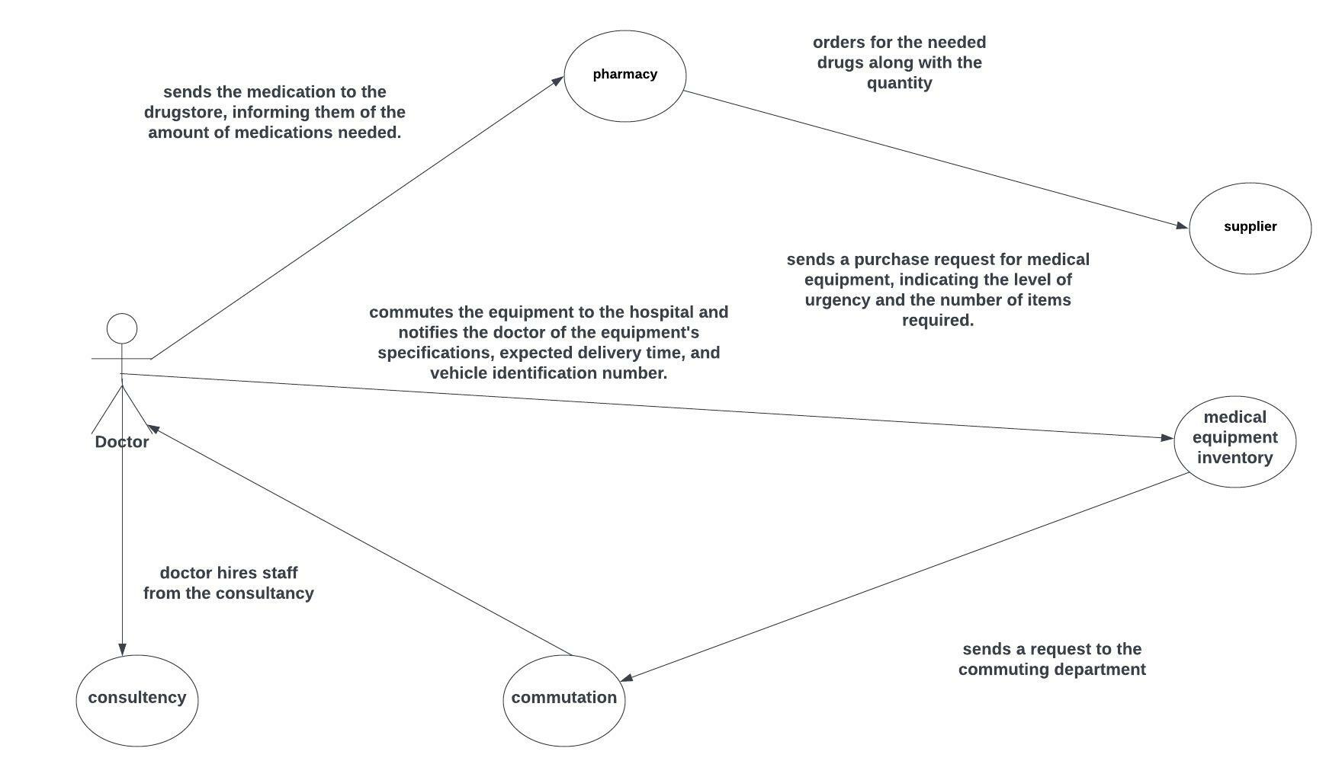
S
USECASE DIAGRAM

Slide 7
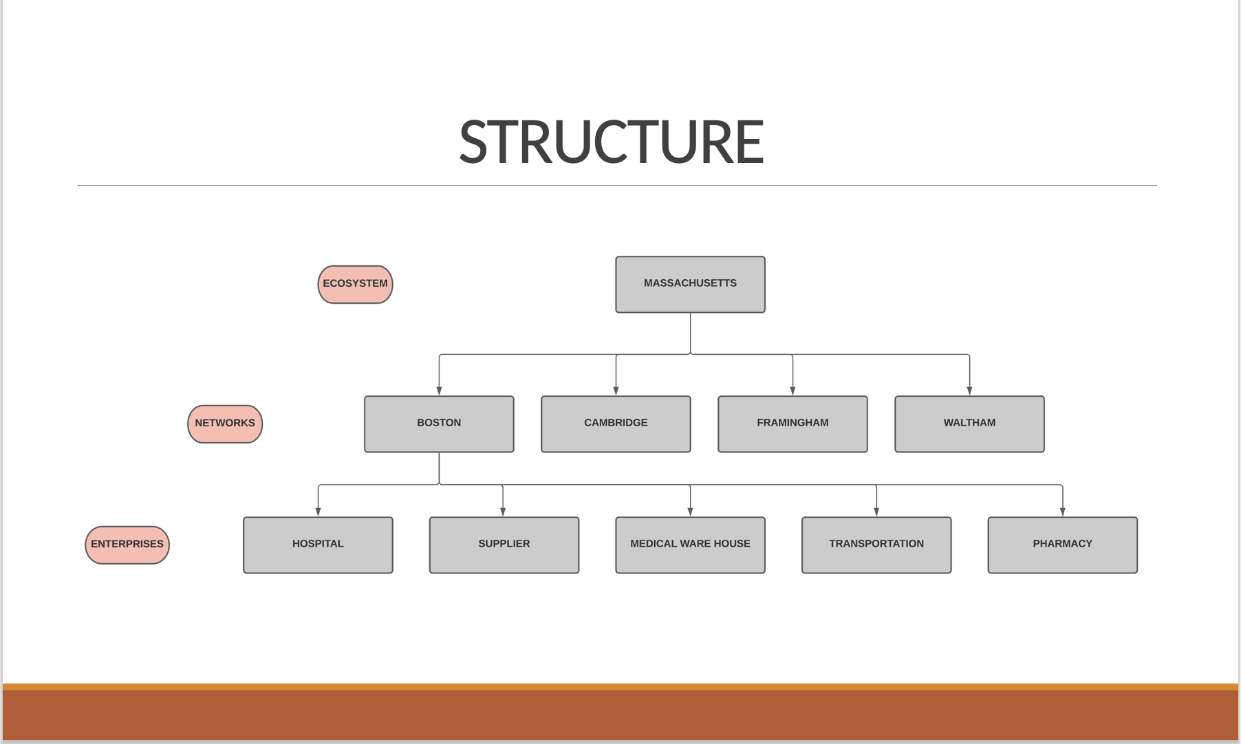

Slide 8
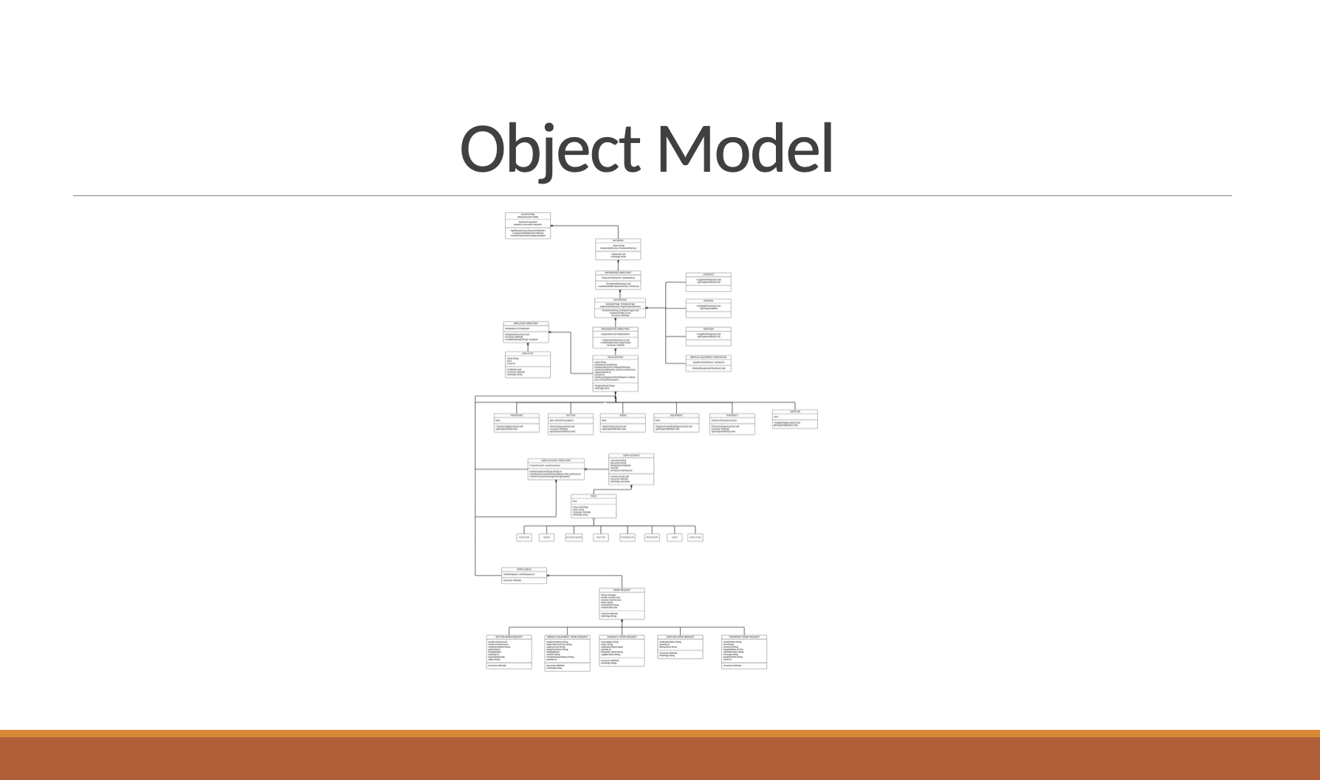

Slide 9
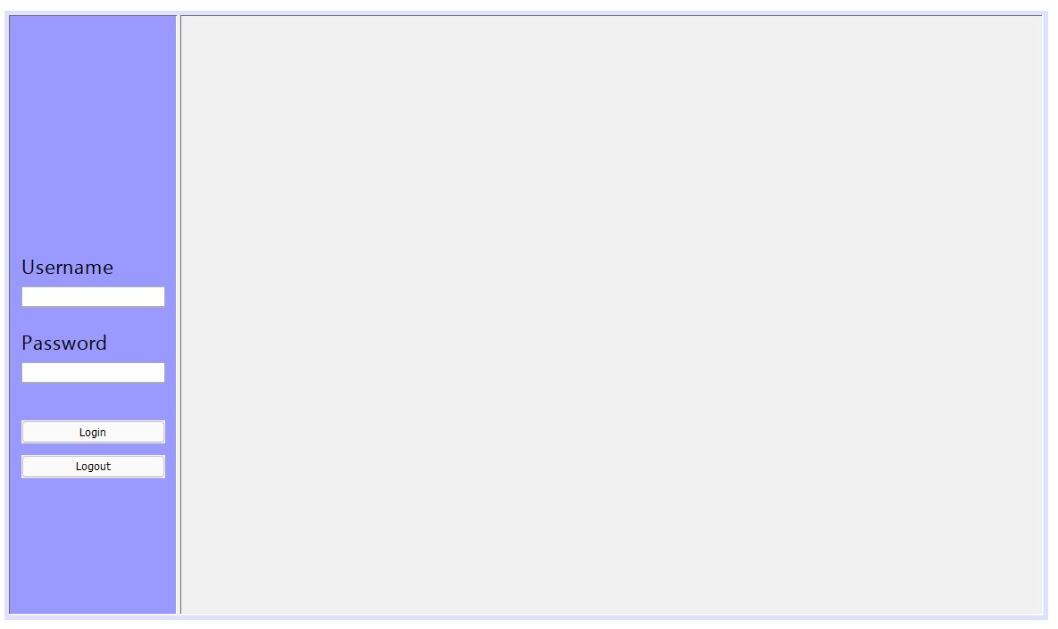

Slide 10
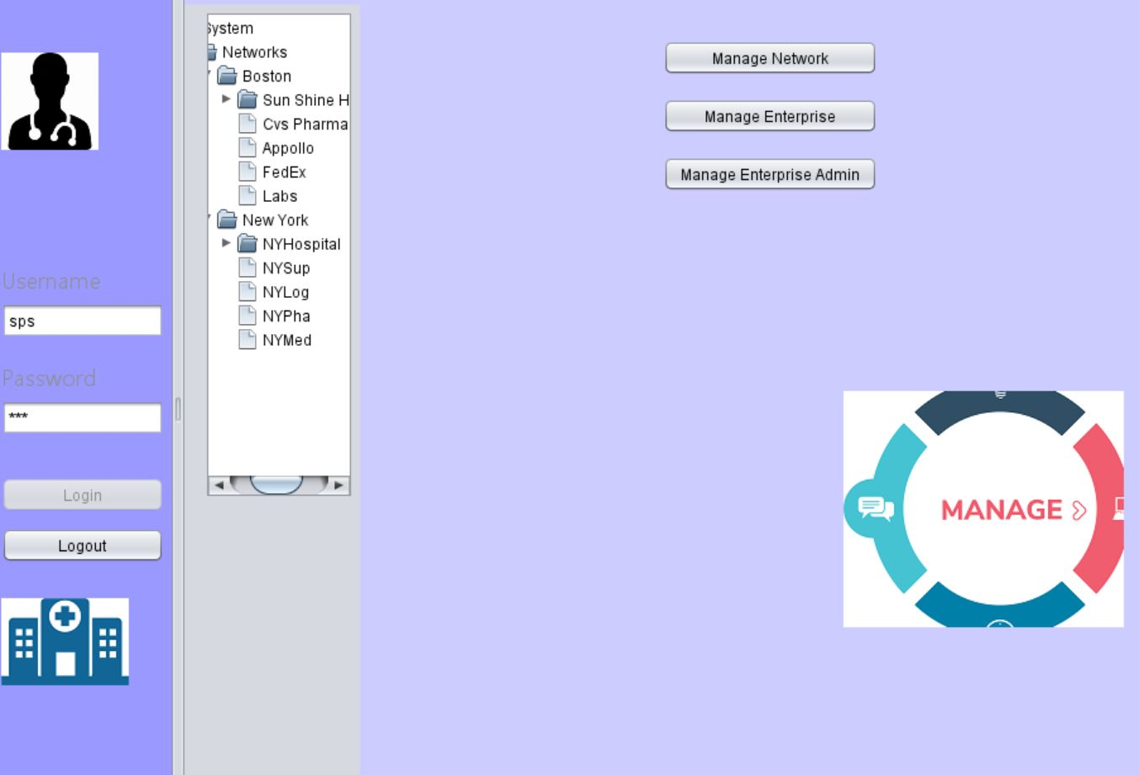

Slide 11
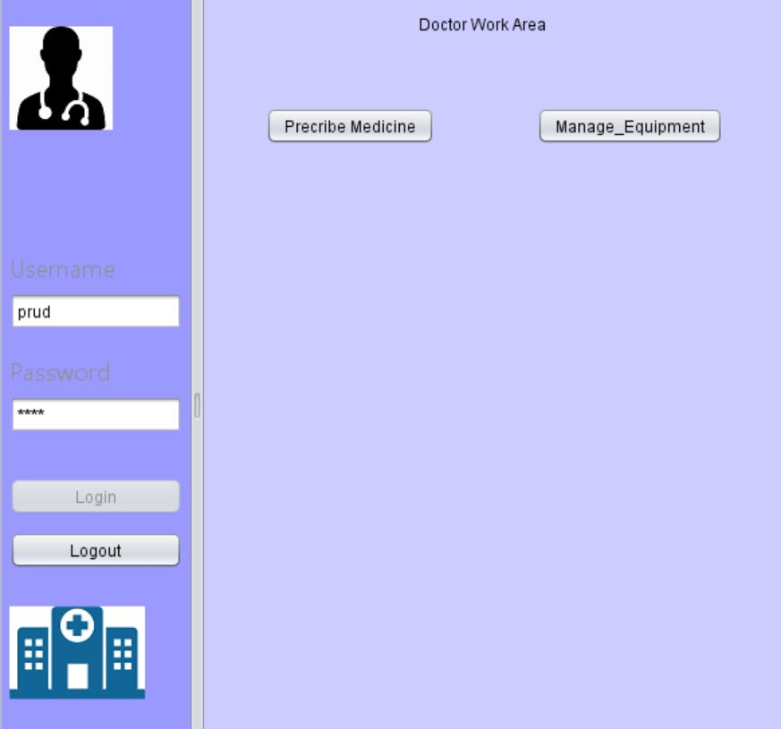

Slide 12
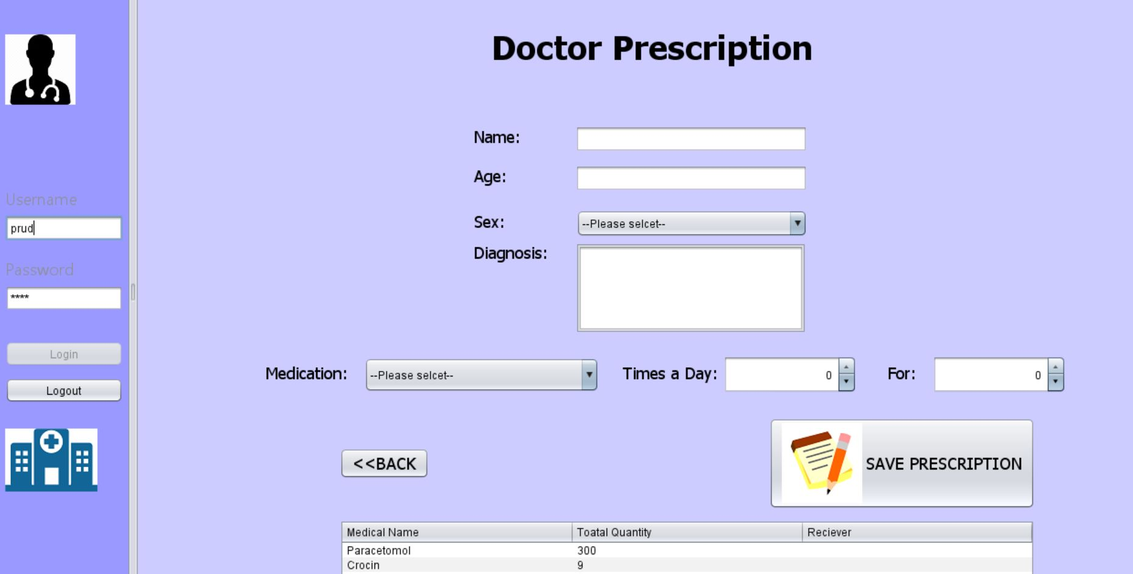

Slide 13
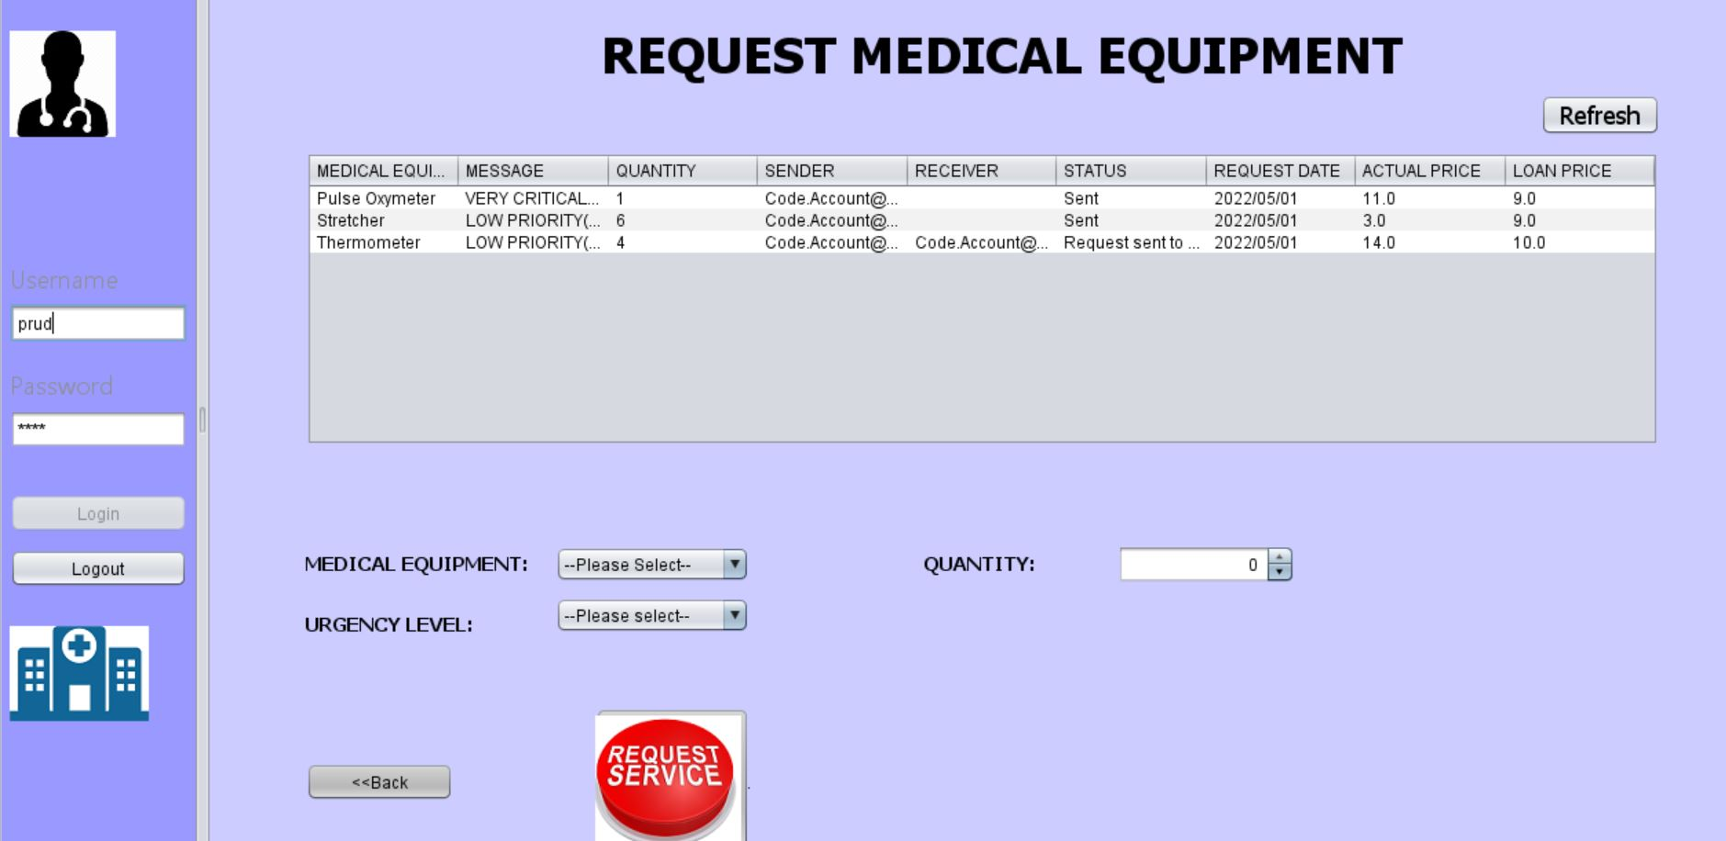

Slide 14
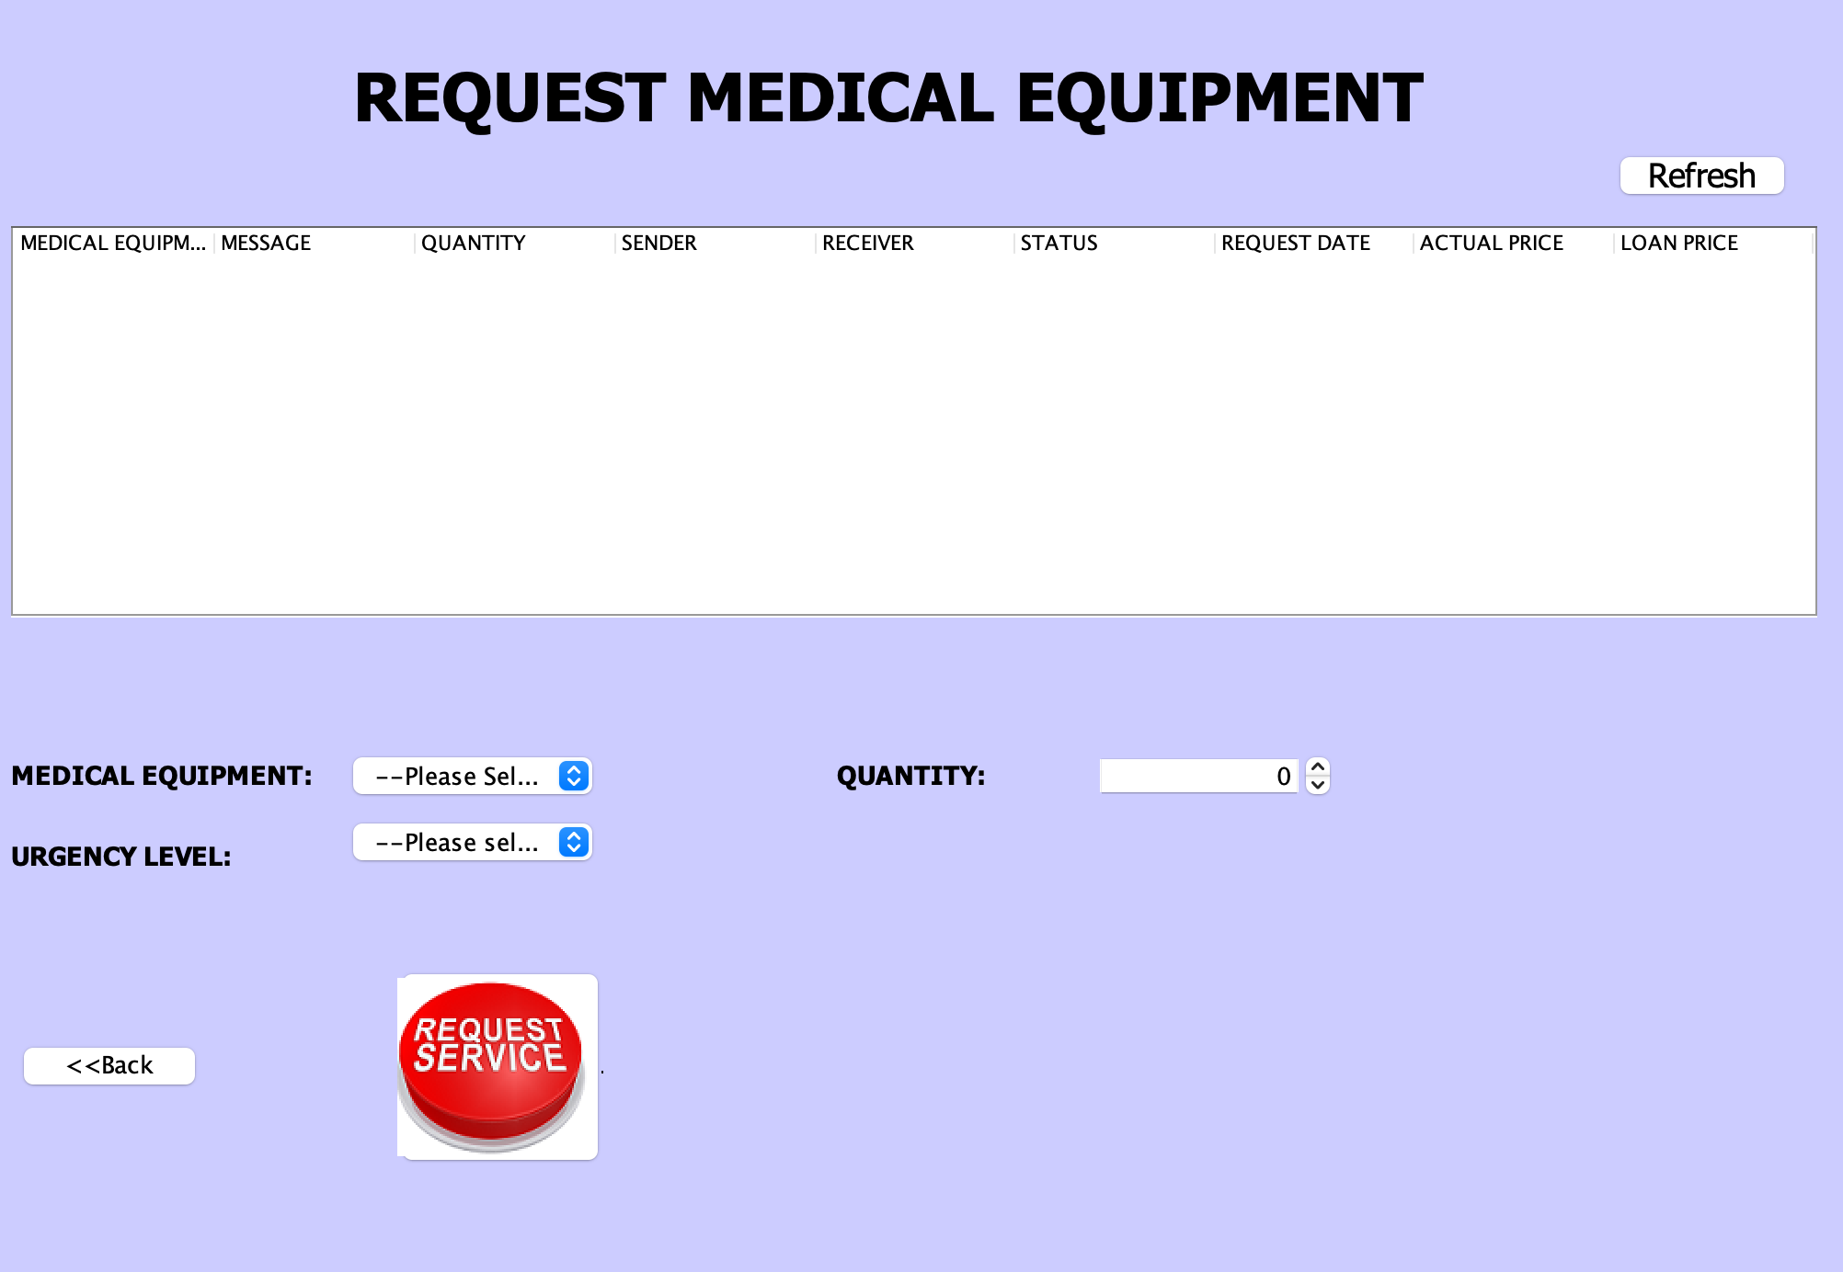

Slide 15
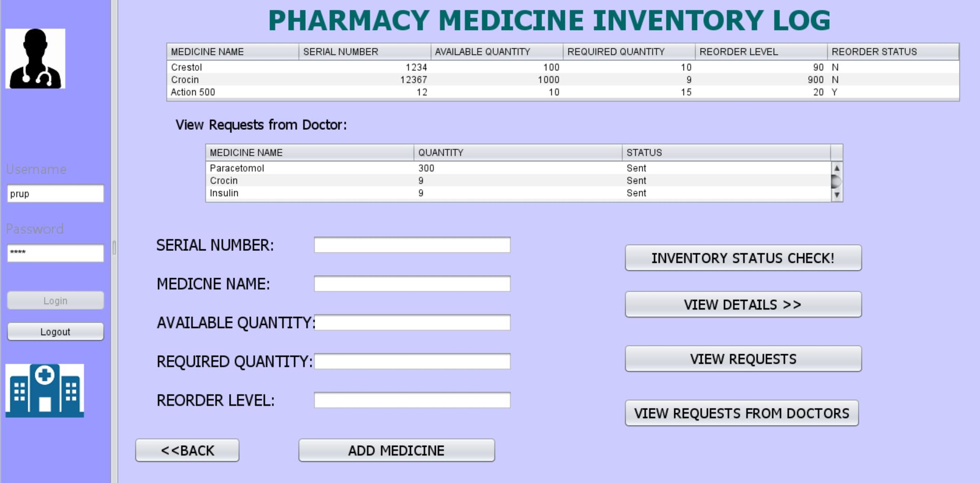

Slide 16
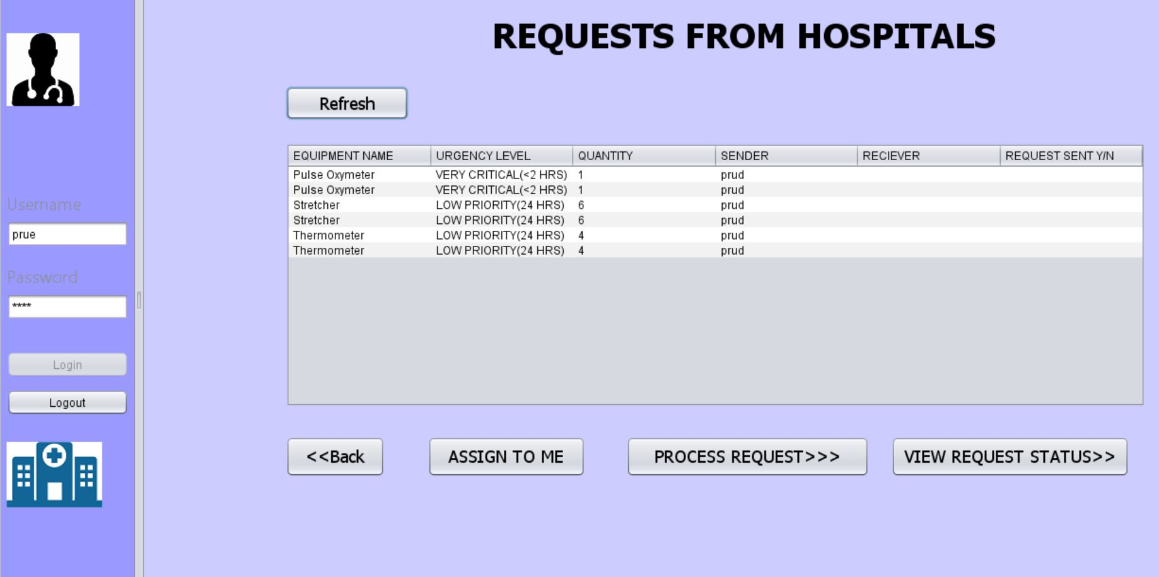

Slide 17
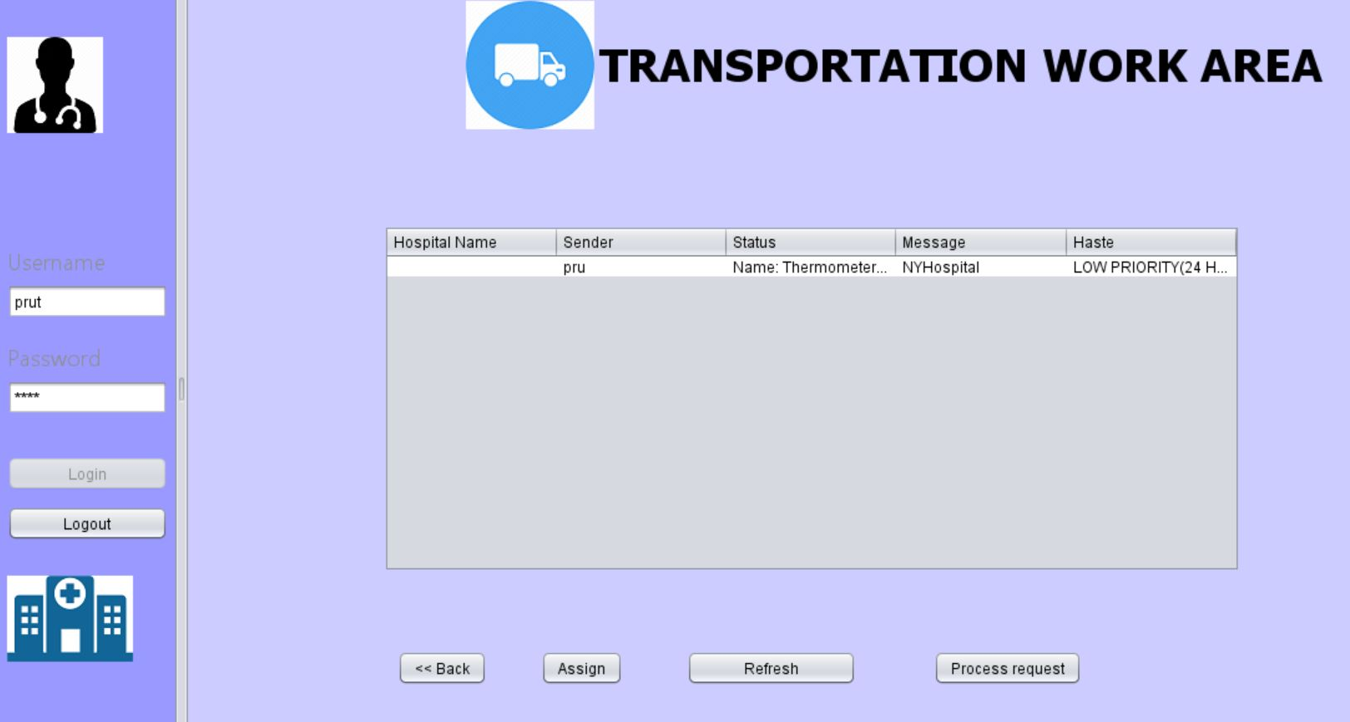

Slide 18
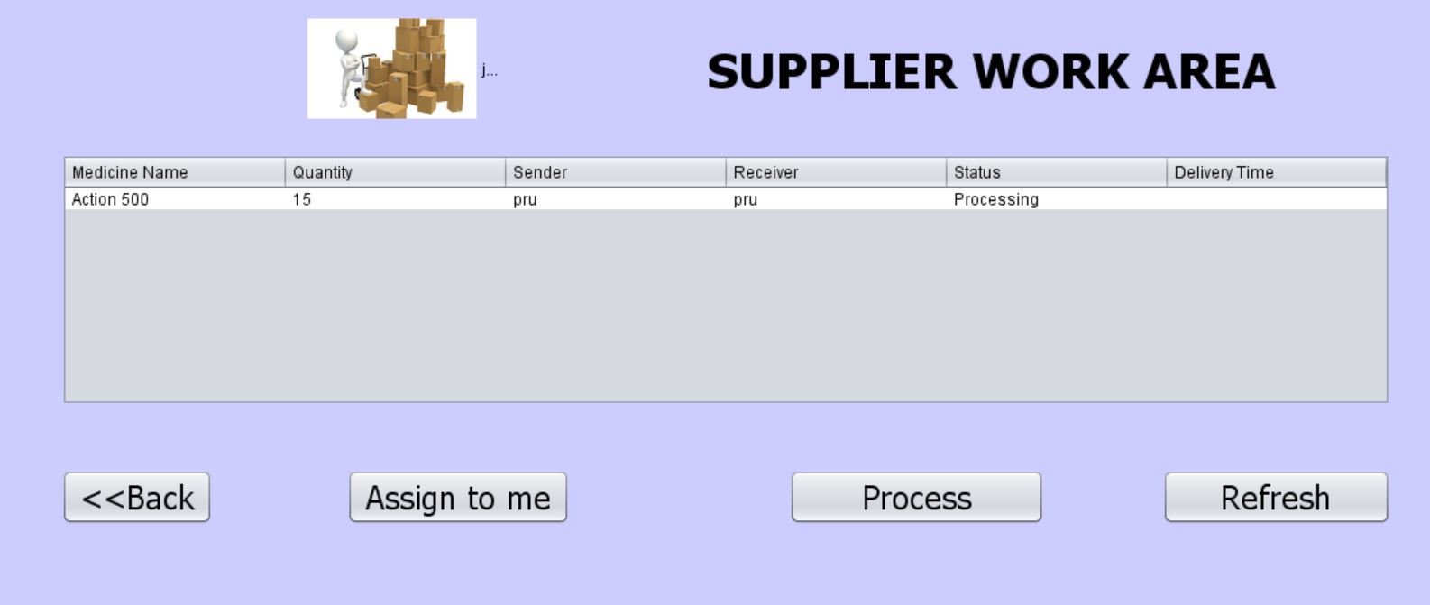

Slide 19
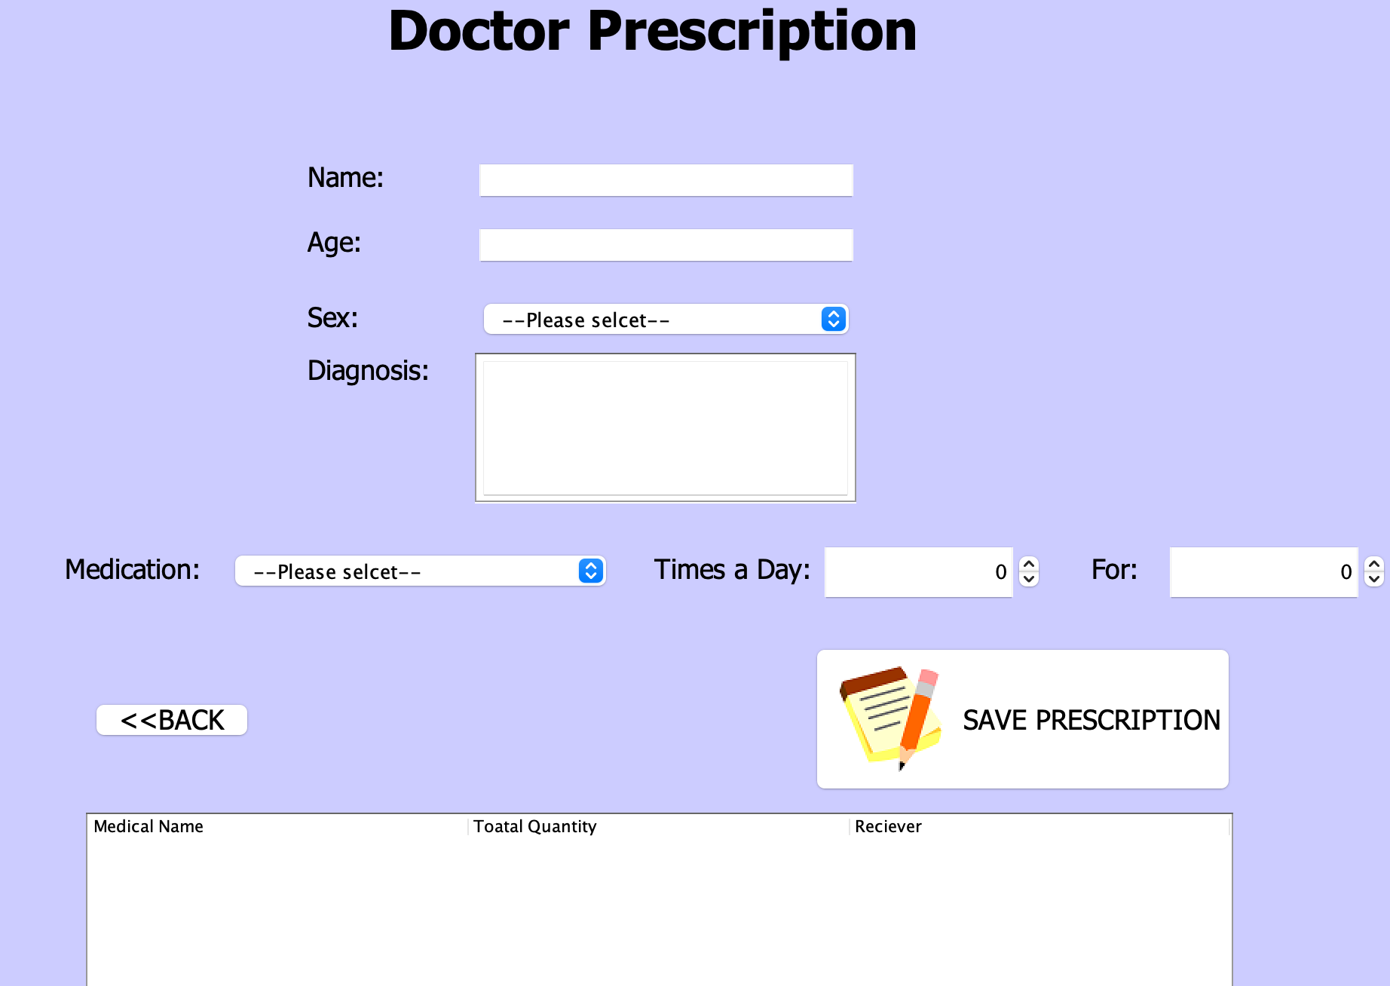

Slide 20
Thank you

